Slide 1
SkyDrive + Push Notification & Roaming Settings Sample
Last Updated: 6/6/2012
Confidential / Internal Use only

Slide 2
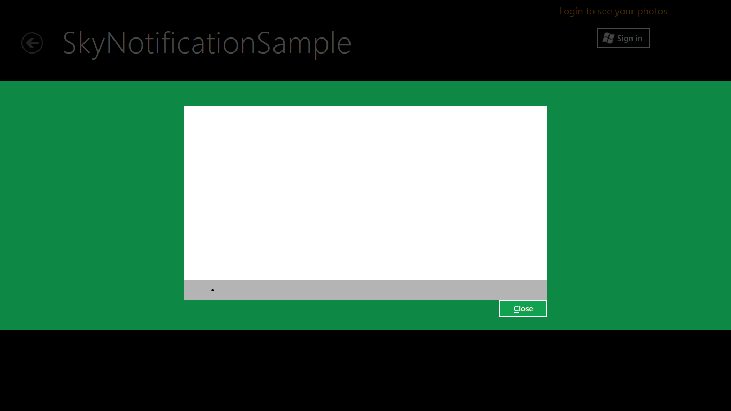
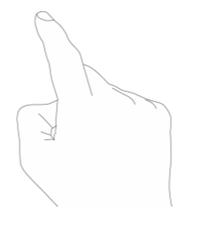

Slide 3
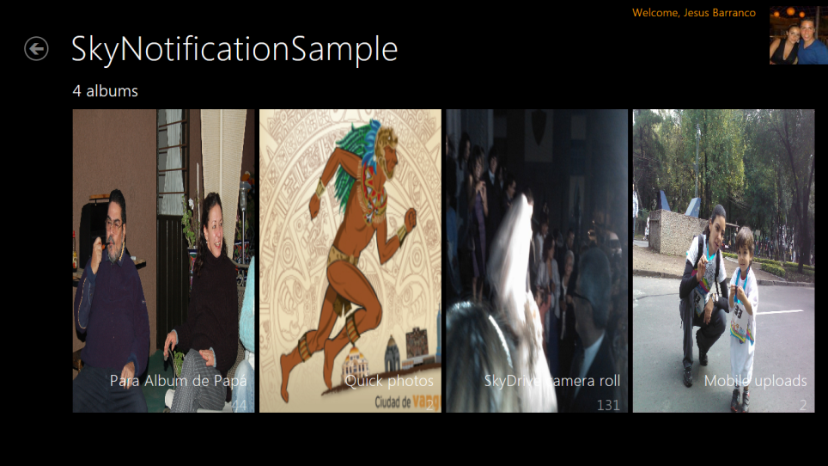

Slide 4
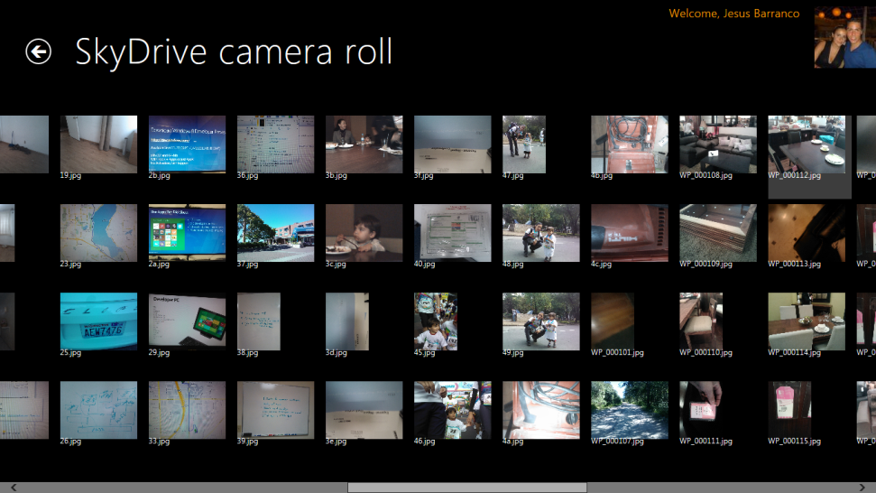

Slide 5
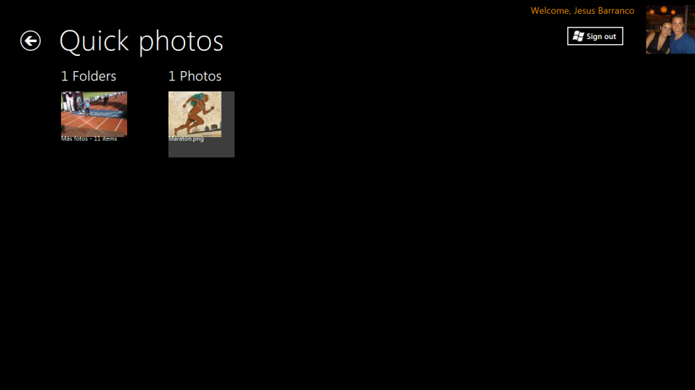

Slide 6
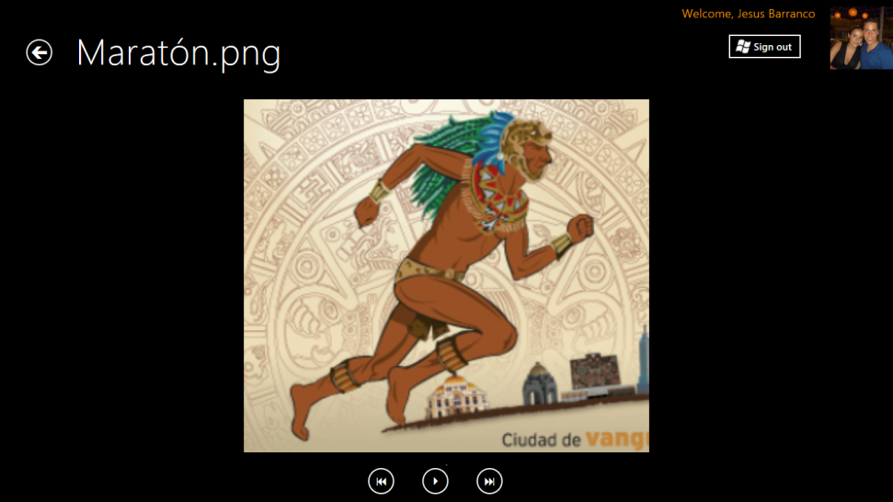

Slide 7
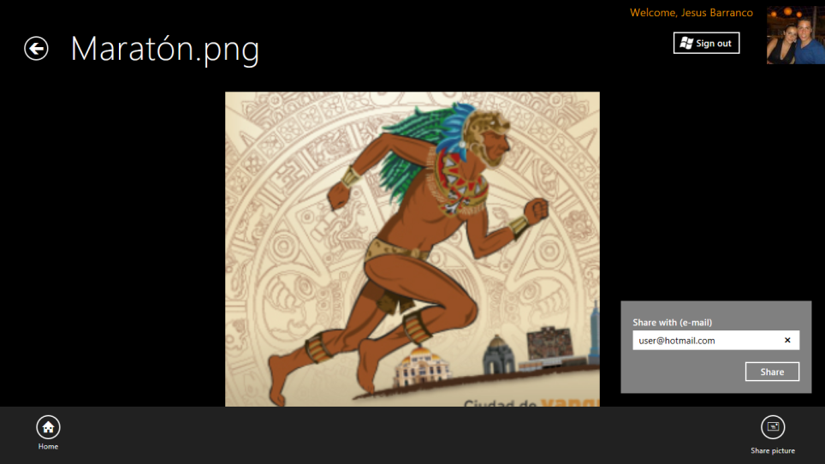

Slide 8
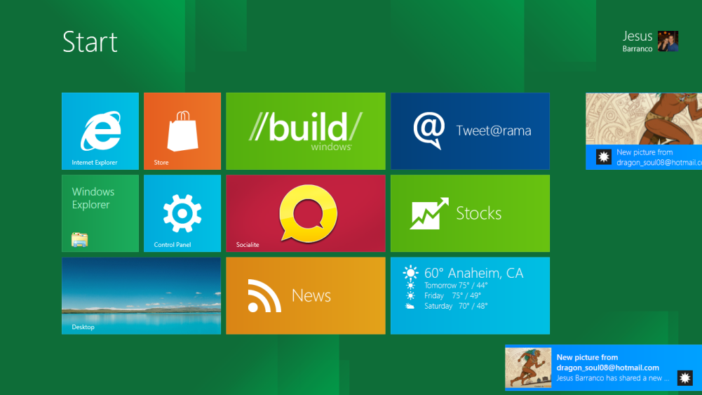

Slide 9
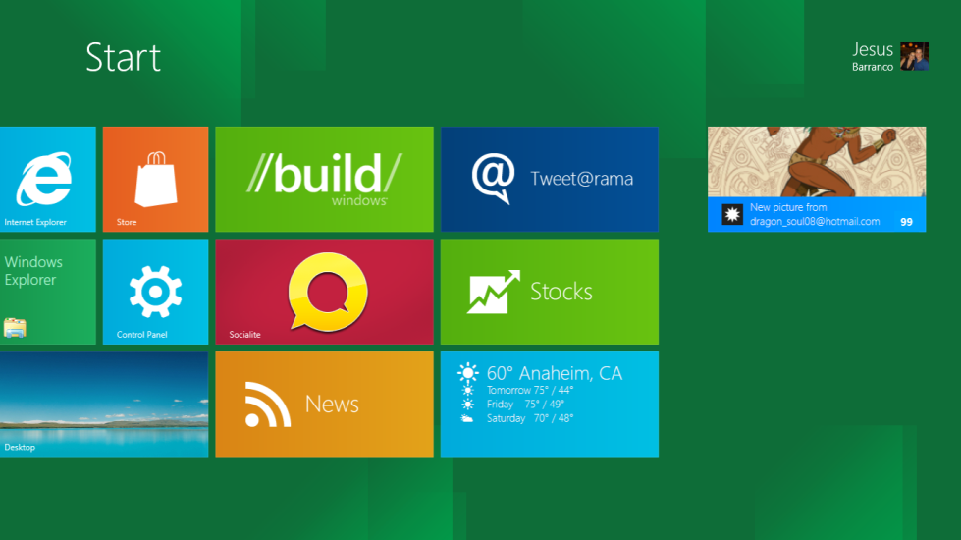

Slide 10
Architecture of the sample

Slide 11
Roaming Settings
The application will keep track of the page, collection and/or picture the user is navigating into. When the user comes back to the application in any device, the application will launch in the place the user left the last time, this is achieved using Live Roaming Settings

Slide 12
Push Notifications
The application uses Windows Push Notification for sending live tiles and toast to other users.
If the intended receipt has the SkyDrive Notification Sample installed then the Server will send a toast and a tile
If the intended receipt doesn’t have the SkyDrive Notification Sample installed then it should only send a plain e-mail

Slide 13
Windows 8
App Service
(WNSSkyDriveService.sln)
Metro Style App
(SkyNotificationSample.sln)
2
POST <channel URI> HTTP/1.1
Content-Type: text/xml
Host: db3.notify.windows.com
X-WNS-Type: wns/badge
Authorization: Bearer <authentication token>
Content-Length: 58
<?xml version="1.0" encoding="utf-8"?>
<badge value="11"/>
3
1
Windows Push Notification Service
Notification
Client Platform
4

